Slide 1
WIRELESS TRANSPORT LAYER SECURITY
(WTLS)

Slide 2
Contents
What is WTLS
Why we need WTLS
What is WTLS
What is TLS
WTLS Functions
Security Algorithm
WTLS Specifications

Slide 3
What is WTLS
It is a security protocol specifically designed for wireless networks, particularly for devices using the Wireless Application Protocol (WAP).
WTLS is based on TLS (Transport Layer Security), but it's optimized for wireless environments where bandwidth, processing power, and memory are limited.

Slide 4
Why we need WTLS
What can we do through the call phone?
Communication
Using Internet
    E-Commerce
    Online Banking
    Trading Stock
Electric Cash
Electric ID
Watching Movie, take a picture etc.

Slide 5
Why we need WTLS
Environment Problems
We need Security Solutions

Slide 6
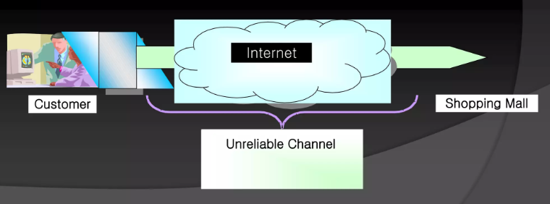
What is TLS
TLS stands for Transaction Layer Security
TLS (Transport Layer Security) is a cryptographic protocol designed to provide secure communication over a computer network, such as the internet. It ensures that data sent between two parties (like a web browser and a web server) is:
SSL Stand for Secure Socket Layer

Slide 7
WTLS Functions
Data Integrity- Data transaction between client device and gateway
Privacy in transaction
Authentication
Dos (Denial of Service) Protection maps to SSL in HTTPS
Optional-support TCP,WDP,WCMP

Slide 8
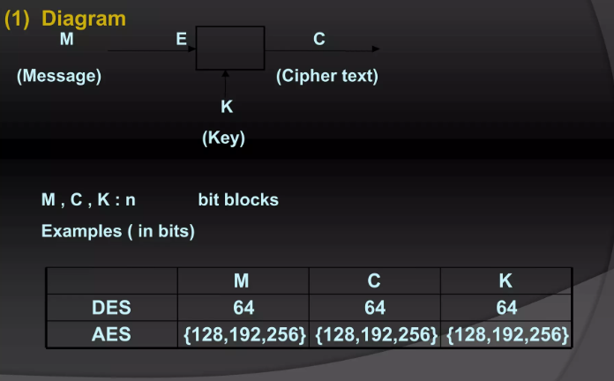
Security Algorithm
Blocker Cipher
Diagram

Slide 9
Security Algorithm
Enryption : combination of substitution and Permutations
Descryption :Inverse of Encryption
Classisal Ciphers
Permutation Ciphers
Substituion Ciphers : Caesar Cipher

Slide 10
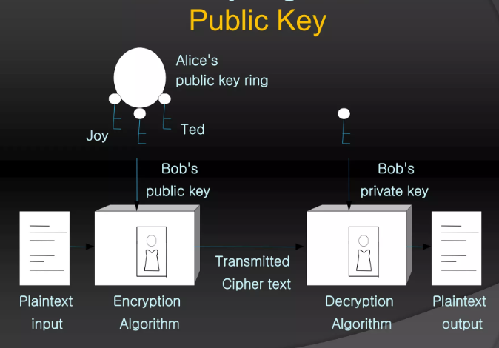
Security Algorithm

Slide 11
WTLS Specifications
Handshake protocol
Full handshake protocol
Abbreviated Handshaking protocol
Optimized Handshaking protocol

Slide 12
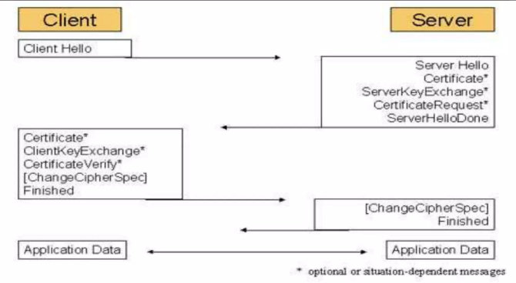
WTLS Specifications
Full Handshaking

Slide 13
WTLS Specifications
A Full Handshake is used when:
The client and server have no prior session or session data (i.e., first-time connection).
The session must establish new keys, perform certificate validation, and negotiate security parameters from scratch.
Key Features:
Exchange of client and server certificates (if required).
Generation of new session keys
Longer time and processing due to complete setup.
More secure, especially when no trust has been previously established.

Slide 14
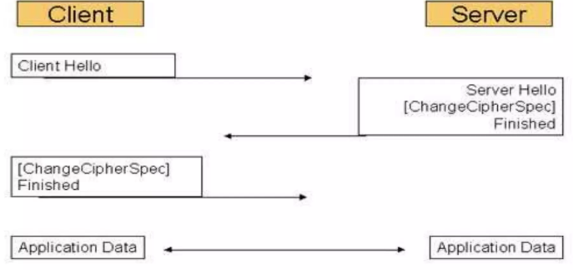
Abbreviated Handshaking
Abbreviated Handshaking

Slide 15
Abbreviated Handshaking
An Abbreviated Handshake is used when:
The client and server have previously communicated.
They use cached session data to resume a previous secure connection.
Avoids expensive computations and certificate re-verification.
Key Features:
Faster connection setup.
Reuses previous session keys or resumption secrets.
Saves on CPU, memory, and bandwidth.
Used in TLS session resumption via Session IDs or Session Tickets.

